Slide 1
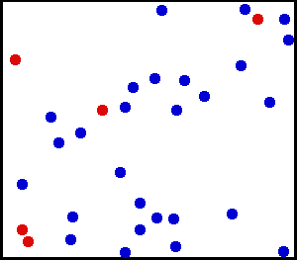
Chapter 13
Phases of matter

Slide 2
http://www.youtube.com/watch?v=akUuFsH4B1c
http://www.youtube.com/watch?v=emAPhKEVu7s&list=PL9AD36FF66D9FA155
http://www.youtube.com/watch?v=ENTDuPdyWR0

Slide 3
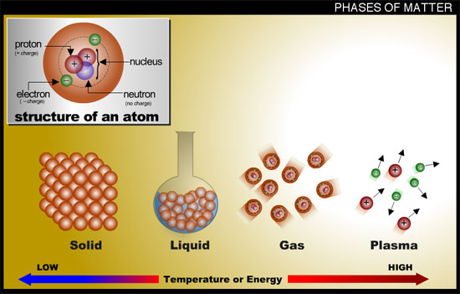
3 (main) Types of Matter Solids, Liquids, and gases

Slide 4
Solids
Definite shape and volume
Are particles in motion
Density greater than liquid and gas forms *

Slide 5
Solids
Types
Atomic (atoms) | Low melting point soft, poor conductors Atoms attached in a solid form | Group 8
Molecular (Molecules) | Held together by intermolecular forces. Low BP and MP, poor conductors | H₂O, sugar
Covalent network | Atoms all covalently bonded to each other. Very hard, poor conductors | Diamond C, Quartz SiO₂ Group 4 elements
Ionic solids | Cations and anions ionically bonded together, hard brittle, high BP and MP. Poor conductors in solid form ( good conductors in solution) | NaCl, CaCo₃
Metallic solids | Good conductors | All metals

Slide 6
Liquids
No definite shape
Definite volume
Fluid- ability to flow
Viscosity- resistance to flow

Slide 7
Liquids
Viscosity- resistance to flow
Depends on:
size of molecule C-C-C-C-C-C-C (higher viscosity)
C-C-C-C (lower viscosity)
Temperature- increase temp => decrease viscosity

Slide 8
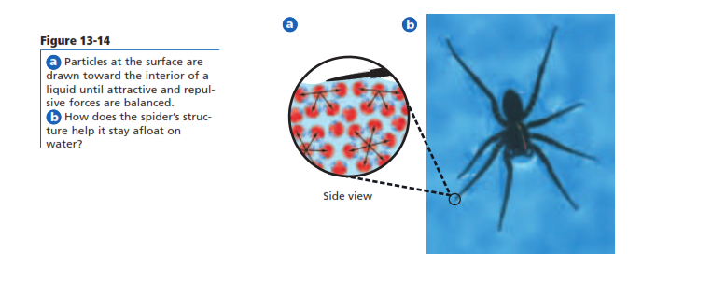
liquids
Surface tension

Slide 9
Gases
No shape
No volume

Slide 10
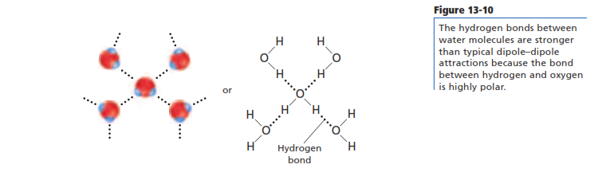
Intermolecular Forces
Hydrogen bonds- occurs between molecules containing hydrogen bonded to a large highly electronegative atom e.g. water.

Slide 11
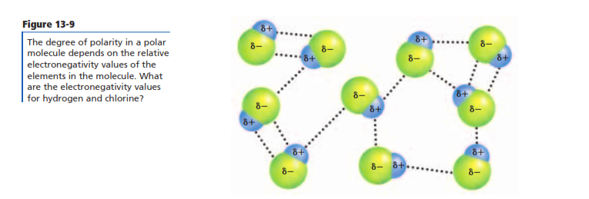
Intermolecular Forces
Dipole-dipole- attractions between oppositely charged particles of polar molecules are called dipole forces e.g. HCl

Slide 12
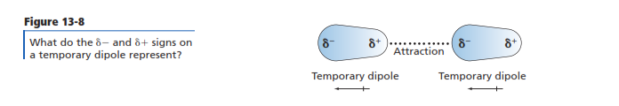
Intermolecular Forces
Dispersion forces- weak intermolecular forces- e.g. O₂ molecule

Slide 13
13.4 Phase Changes
When energy is added or removed from a system, one phase can change into another.

Slide 14
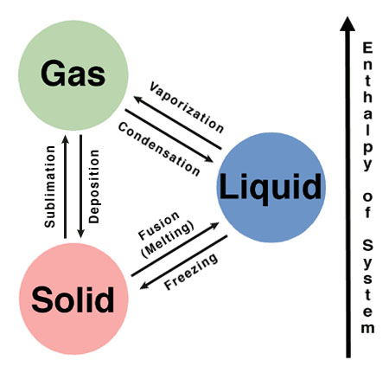
The six possible transitions between phases.

Slide 15
Phase Changes that Require Energy
( Water will be used as a primary example in the discussion of phase changes)
Melting
Heat is the transfer of energy from an object at higher temperature to an object of lower temperature.
When molecules of ice absorb enough energy to break the hydrogen bonds, they break apart and enter the liquid phase.
The energy absorbed by the ice does not raise the temperature of the ice, until all the ice is melted.
The temperature at which a solid becomes a liquid is called it’s Melting Point.
Once all the ice has melted, the temperature (kinetic energy) will increase.

Slide 16
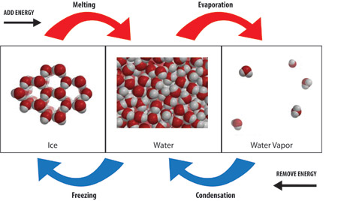
Phase Changes that Require Energy

Slide 17
Phase Changes that Require Energy
Vaporization
The process by which a liquid changes to a gas or vapor.
When vaporization occurs only at the surface of a liquid, the process is called evaporation.
The pressure exerted by a vapor over a liquid is called vapor pressure.
The temperature at which the vapor pressure of a liquid equals the external or atmospheric pressure is called the boiling point.
At the BP, molecules have enough energy to vaporize.

Slide 18
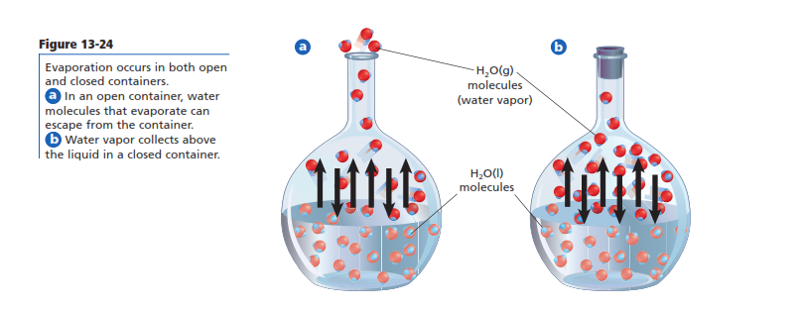
Phase Changes that Require Energy

Slide 19
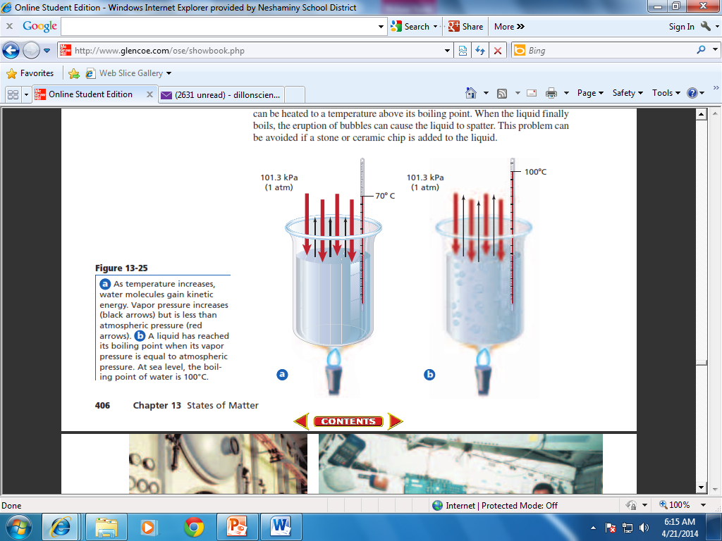
Phase Changes that Require Energy

Slide 20
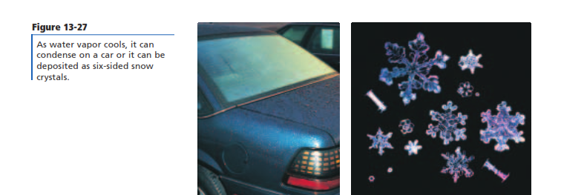
Phase Changes that Require Energy
Sublimation
The process by which a solid changes directly to a gas without first becoming a liquid.
Solid iodine, carbon dioxide (dry ice), moth ball (naphthalene) and air freshener sublime at room temperature.

Slide 21
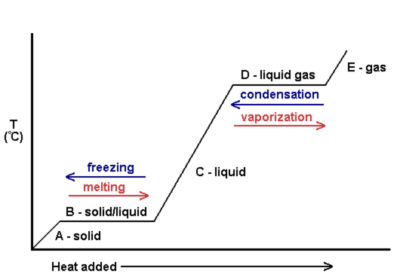
Phase Changes

Slide 22
Other substances that expand on freezing are silicon, gallium, germanium, antimony, bismuth, plutonium and also chemical compounds that form spacious crystal lattices with tetrahedral coordination.

Slide 23
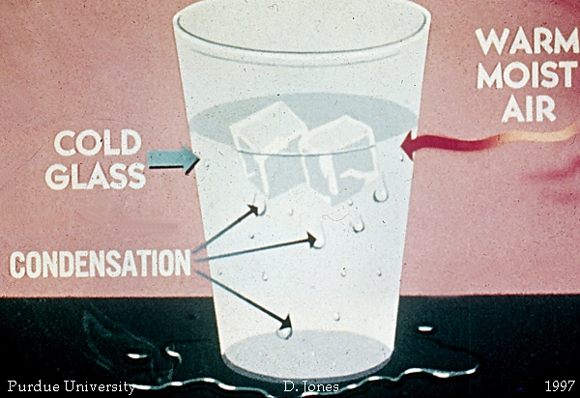
Phase Changes that Release Energy
Condensation
The process by which a gas becomes a liquid is called condensation.
Condensation is the reverse of vaporization. When hydrogen bonds form in liquid water, energy is released.
When a water molecule loses energy, its velocity is reduced and a hydrogen bond forms when it collides with another water molecule.

Slide 24
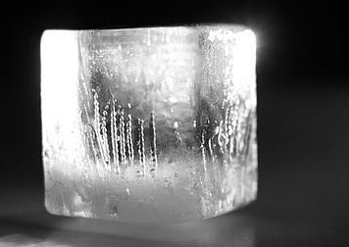
Phase Changes that Release Energy
Freezing
When a substance changes from a liquid to a solid phase it is called freezing.
The freezing point is the temperature at which a liquid is converted to a solid (melting point and freezing point are the same temperature).

Slide 25
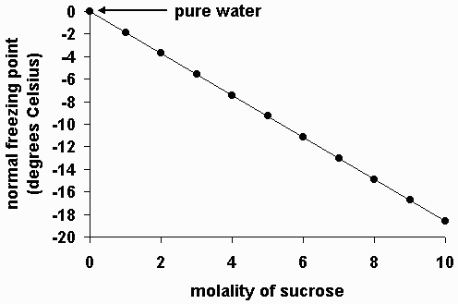
Freezing Point

Slide 26
Phase Changes that Release Energy
Freezing
As heat is removed from water, the molecules lost kinetic energy and their velocity decreases.
When enough energy is removed, the hydrogen bonds between the water molecules keep the molecules fixed, or frozen, into set positions.
Freezing is the reverse of melting

Slide 27
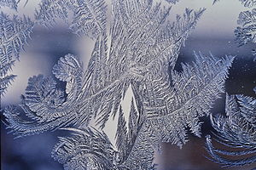
Phase Changes that Release Energy
Deposition
The process by which a substance changes from a gas or vapor directly to a solid without going through the liquid phase.
Deposition is the reverse of sublimation.
Frost and snow formation are examples of deposition

Slide 28
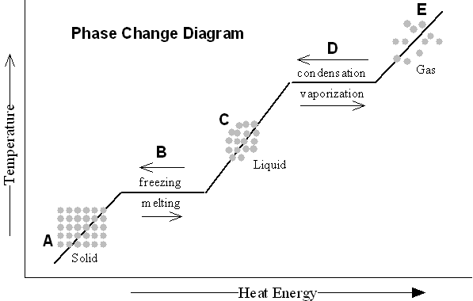
Phase Changes

Slide 29
Phase Changes that Release Energy

Slide 30
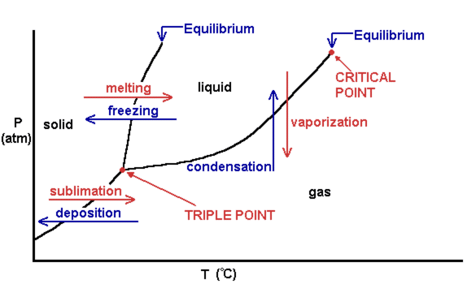
Phase Diagrams
A phase diagram is a graph of pressure verses temperature that shows in which phase a substance exists under different conditions of temperature and pressure.

Slide 31
Phase Diagrams
Used to predict what phase a substance will be in for any combination of pressure and temperature.

Slide 32
Phase Diagrams
There are three regions representing solid, liquid and vapor phases, and three curves that separate the regions from one another.

Slide 33
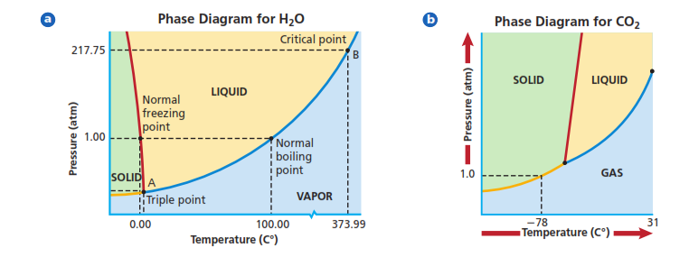
Phase Diagrams
At points that fall along the curves, two phases of a substance can coexist.

Slide 34
Phase Diagrams
All six phase changes can occur at the triple point.

Slide 35
Phase Diagrams
The critical point is the temperature and pressure at which a substance cannot exist as a liquid (an increase in pressure will not change the vapor to a liquid).

Slide 36
Phase Diagrams

Slide 37
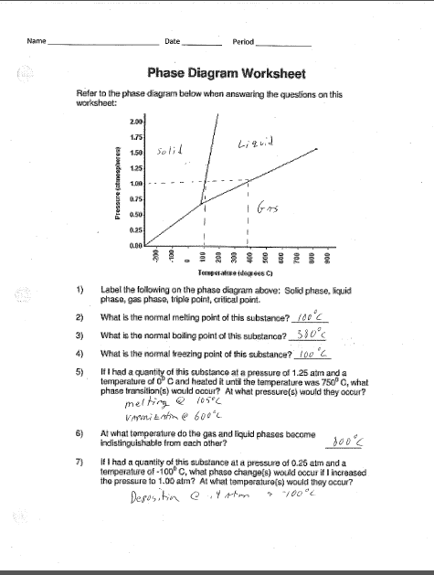

Slide 38
